Slide 1
CURRENT STATE OF PHYSICIAN REVIEWS ON HEALTHGRADES.COM
Webscraping project presentation
Yan Qi
1/30/2017

Slide 2
Background
What is Healthgrades.com?
It is a website listing comprehensive physician and hospital profiles to facilitate connection between patients and providers
Yelp for doctors?! Patients can search for physicians based on specialty, location, and read the detailed doctors profile in order to choose a provider
Each doctor’s page includes reviews from patients in the form of star ratings and qualitative comments
Physician profiles also include demographic information, practice location, areas of expertise, medical training history, etc.
Project Objective
Analyze physician performance by looking at patient reviews
Understand what physician characteristics impact rating
Assess data quality and caveats from this website and implications

Slide 3
Outline
Introduction to the dataset
Distribution of overall rating
What drives / influences overall rating?
Number of reviews
Age
Gender
Doctor’s performance vs. office staff performance
Conclusions
Future work

Slide 4
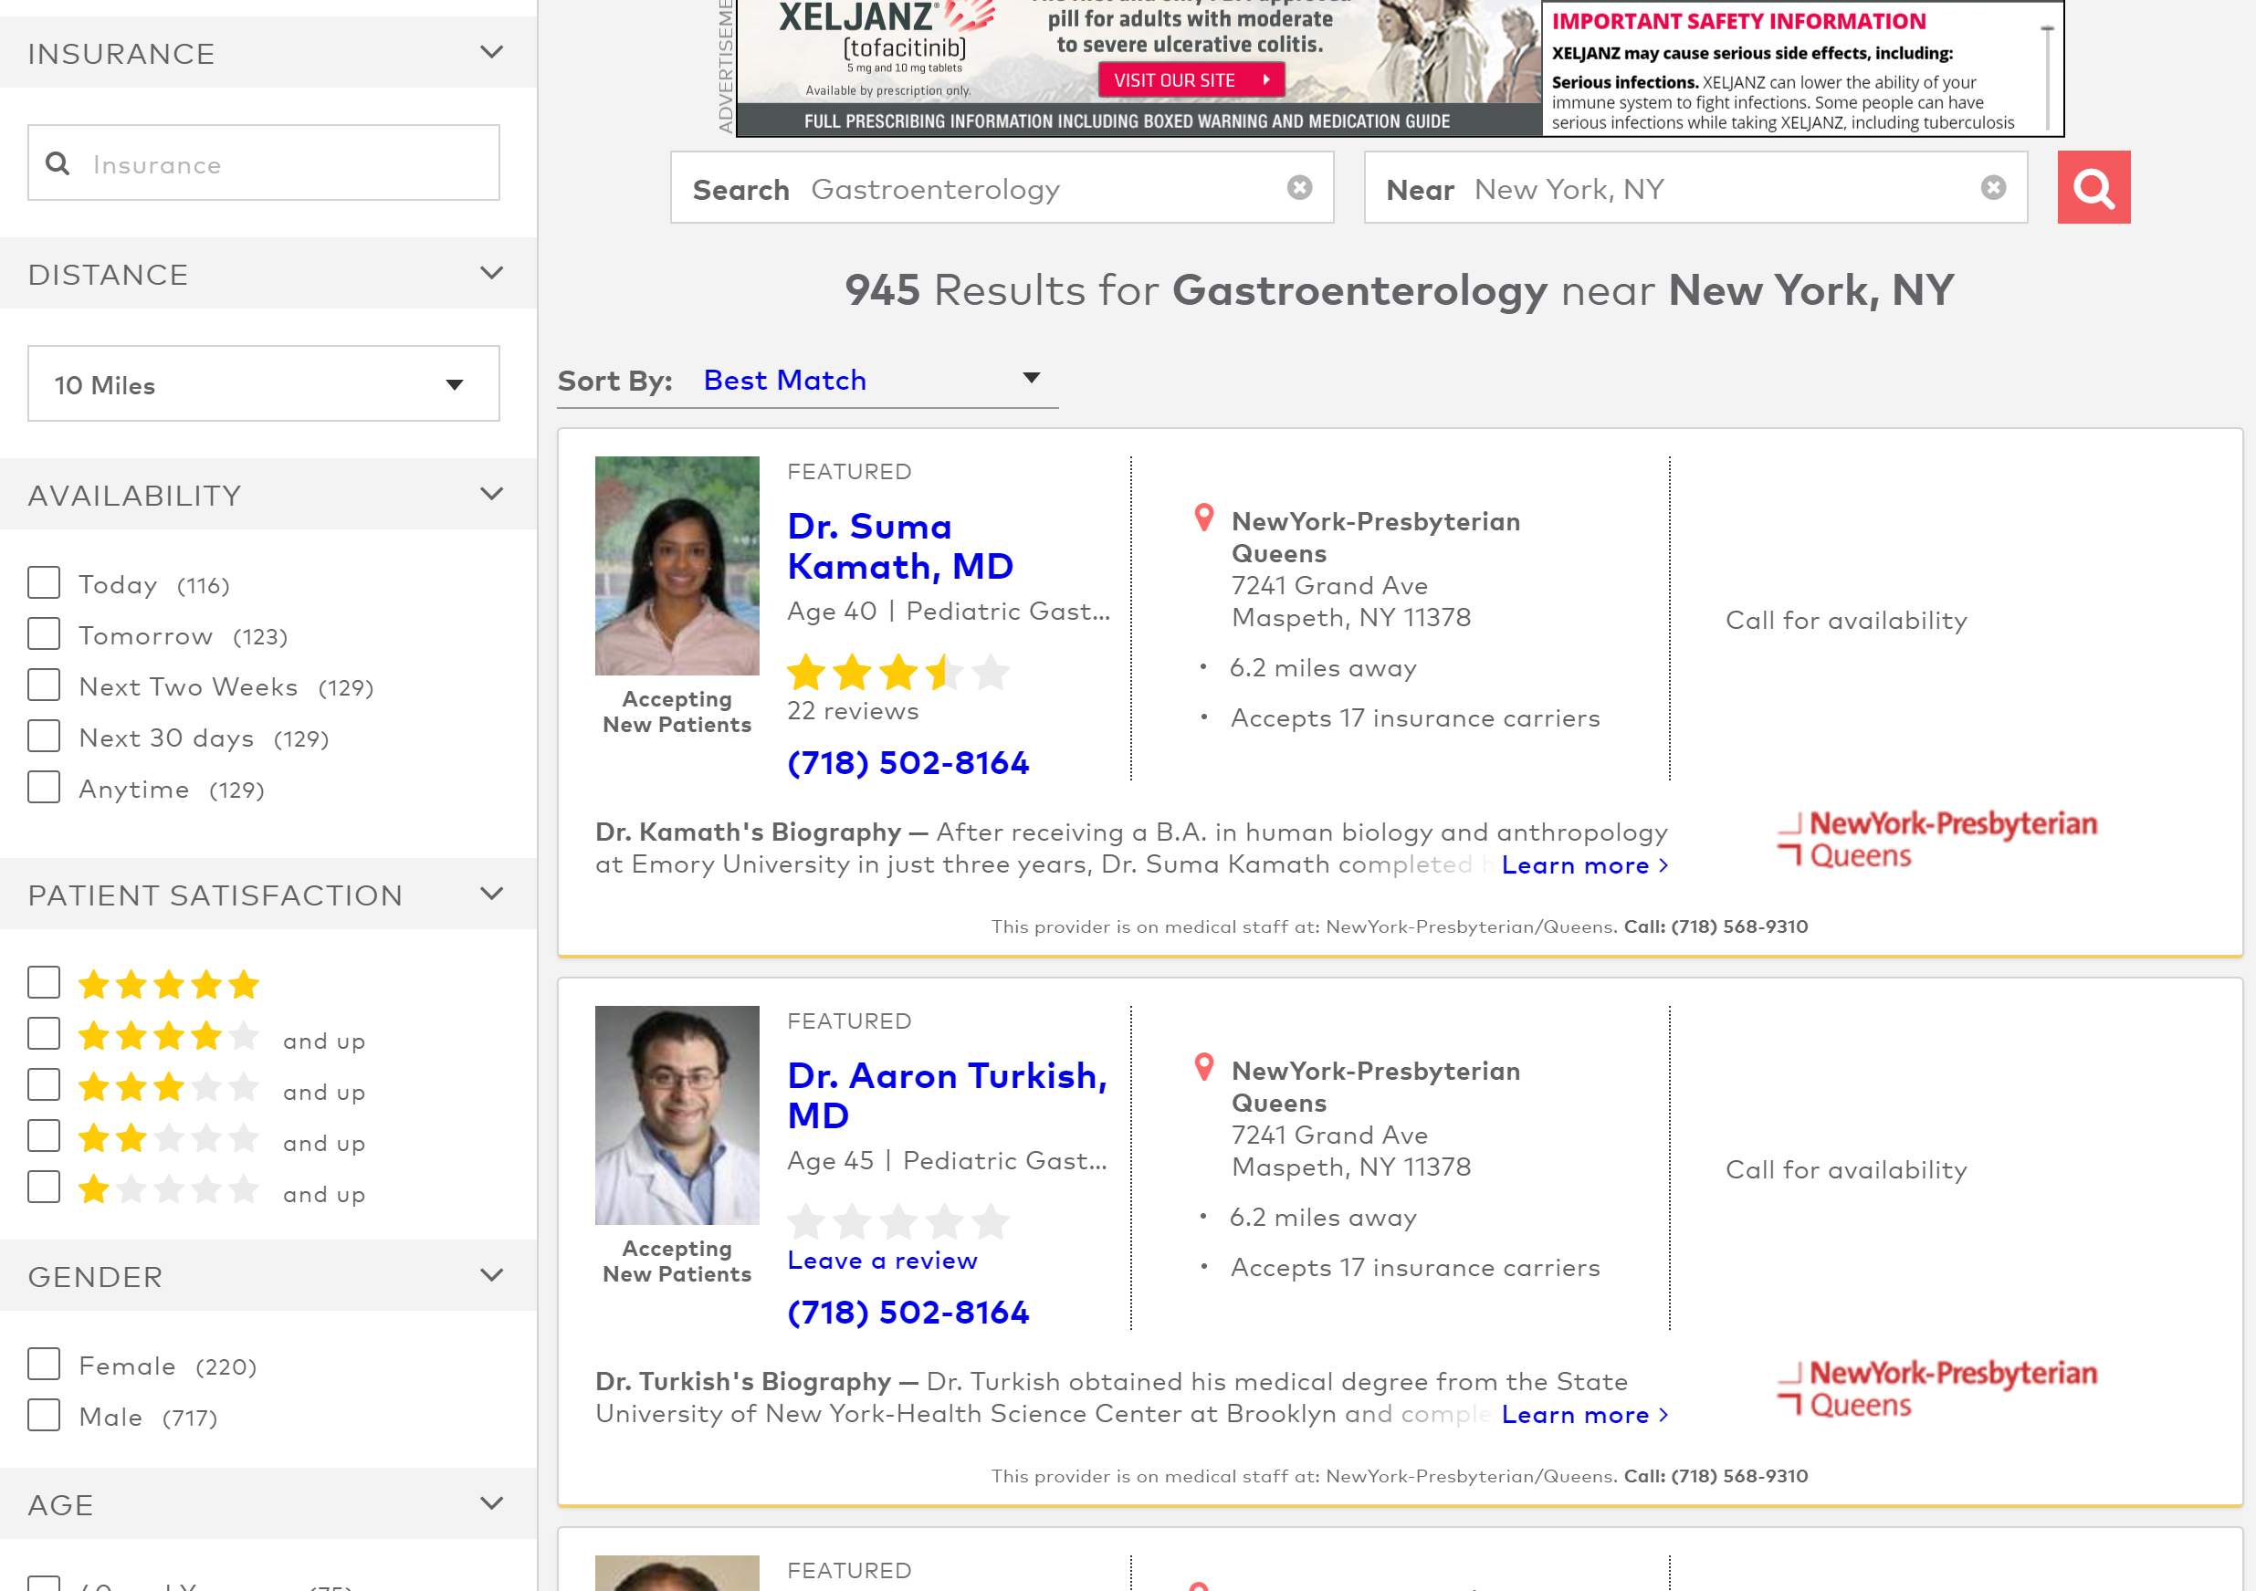
Pilot analysis includes ~950 gastroenterologists in New York City metro area
Starting URL: https://www.healthgrades.com/gastroenterology-directory/ny-new-york/new-york

Slide 5
Ratings and doctor demographic information were scraped for analysis
Ratings through patient survey (1-5 stars rounded to 0.5 star precision)
Overall Rating | Likelihood to recommend doctor to friends and family
Doctor Score | Level of trust in provider's decisions
 | How well provider explains medical condition(s)
 | How well provider listens and answers questions
 | Spends appropriate amount of time with patients
Staff Score | Ease of scheduling urgent appointments
 | Office environment, cleanliness, comfort, etc.
 | Staff friendliness and courteousness
Doctor characteristics
Used in analysis Age Gender Number of reviews
Scraped, not used Main practice name Main practice address Educational history (medical school, residency, fellowship hospitals) Number of insurance plans accepted
Not scraped Qualitative comments from patient reviews Top conditions and procedures Legal action background check Languages spoken
Healthgrades has collected > 5 million patient reviews nationally

Slide 6
The NY Metro GI doctor data contained a number of missing values for the different variables
Variable | % of Missing Value | N available for analysis
Age | 22% | 737
Gender | 7% | 884
Overall Rating / Doctor Score / Staff Score | 28% | 681
Practice Name | 12% | 681
Fellowship Hospital | 41%
Residency Hospital | 33%
Medical School | 25%
Number of Insurance Accepted | 94%
Total Number of Doctors in initial scraped dataset: 947
Notes:
Cardiology stats (total 1572): comparable
age 19%
gender 9%
rating 37%
practice_name 13%
hosp_fellow 40%
hosp_md 23%
hosp_res 32%

Slide 7
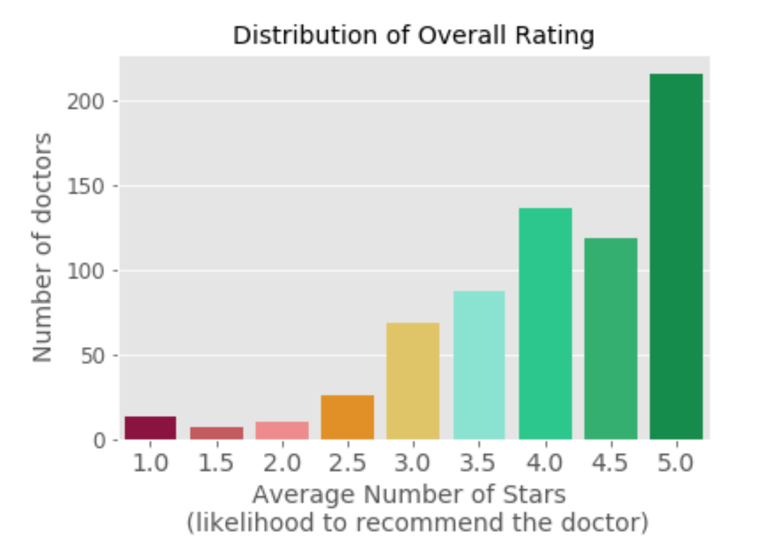
On first glance, it would appear that more than a third of doctors are getting perfect 5 stars …
N = 681
Including all doctors with at least 1 review
But, a 5 star rating based on 1 review ≠ a 5 star rating based on 10 reviews!

Slide 8
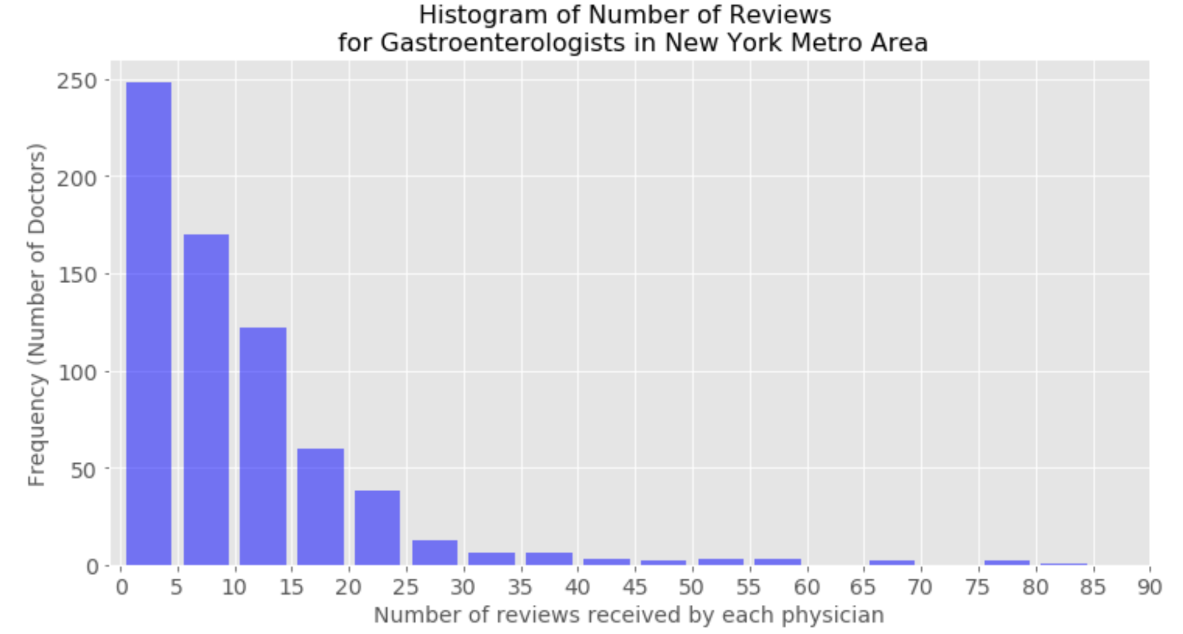
The number of reviews follows an extremely skewed distribution with 36% doctors each having < 5 reviews
Number of Reviews | % of Doctors
1 – 4 | 36%
5 – 9 | 25%
10 or more | 39%
30 or more | 4%
50 or more | < 2%
N = 681
Including all doctors with at least 1 review
Max = 158 (not shown)
Notes:
With all 947 doctors:
Mean: 7.4
Std: 11.6
Median: 4
75%: 11
Max: 158
Results for Cardiologists: even more skewed.

Slide 9
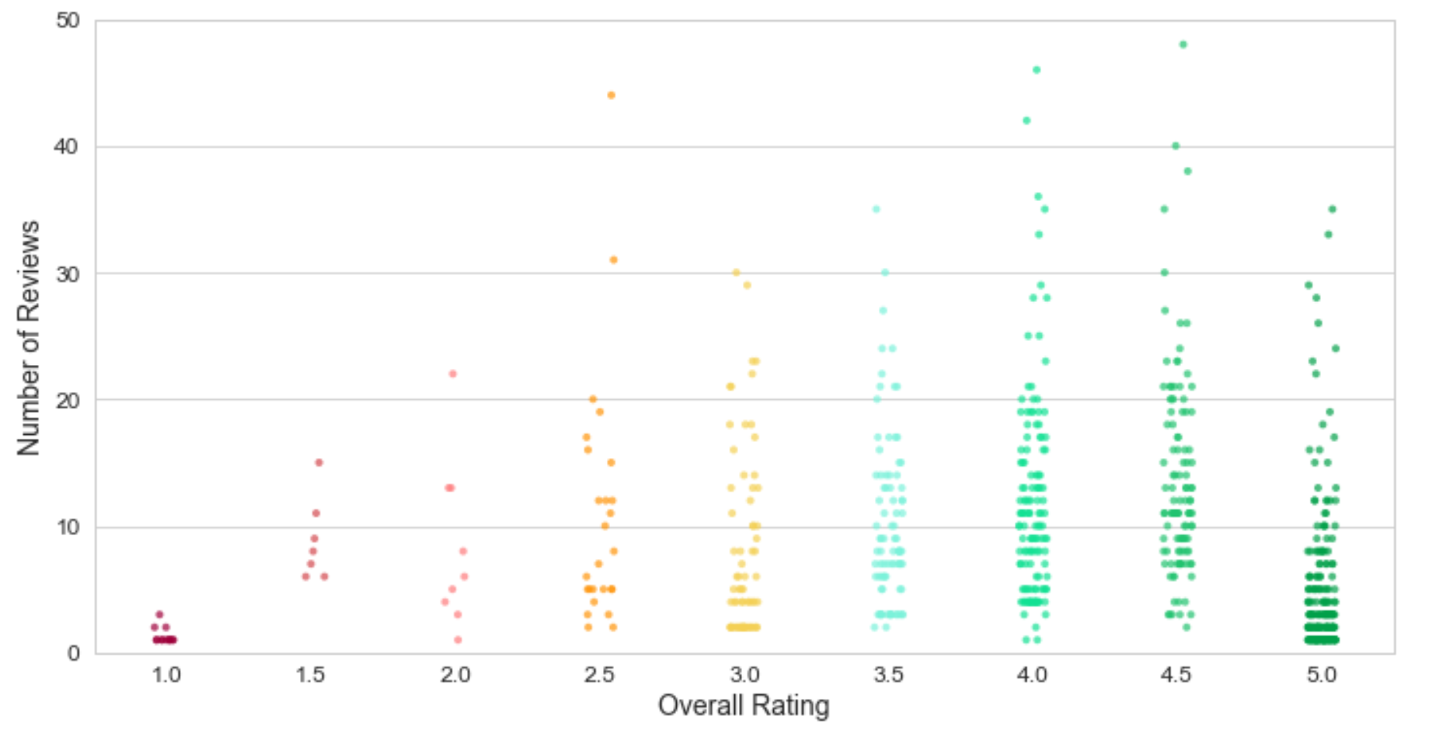
Examining rating in conjunction with the number of substantiating reviews help consumer pick providers in a more reliable way
Avoid if has other choice
Top of the crop
Exceptional
1
2
3
Doctors with low rating in generally much less likely to get a large number of reviews
Among patients submitting a review, more are motivated by positive than negative experiences
Notes:
Similar trends for cardiologists
Check exceptional group

Slide 10
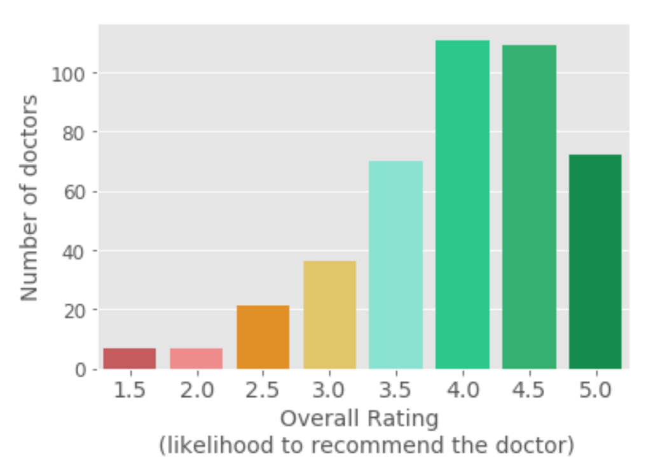
Only including ratings based on 5 or more reviews, the distribution still looks very favorable toward high scores
Hypotheses
25%
25%
The average quality of gastroenterologists in NY metro area is very high and patients are truly highly satisfied
Selection bias in those who are willing to submit a survey vs. those who are not
N = 433
Including all doctors with at least 5 reviews
16%
17%
8%
5%
2%
2%
What factors influence the overall rating?
Notes:
Mean = 4.0
Std = 0.8

Slide 11
We will explore the relationship between rating and doctor age, gender, and doctor’s own vs. office staff’s performance
Factor | Question
Doctor’s own performance vs. Staff Performance | How well do doc score and staff score correlate with overall rating? How well does doctor score correlate with staff score? What kind of impact does office staff’s performance have on the doctor’s overall rating?
Age | Do experienced doctors get better reviews?
Gender | Is there any difference between the ratings received by female vs. male GI specialists?

Slide 12
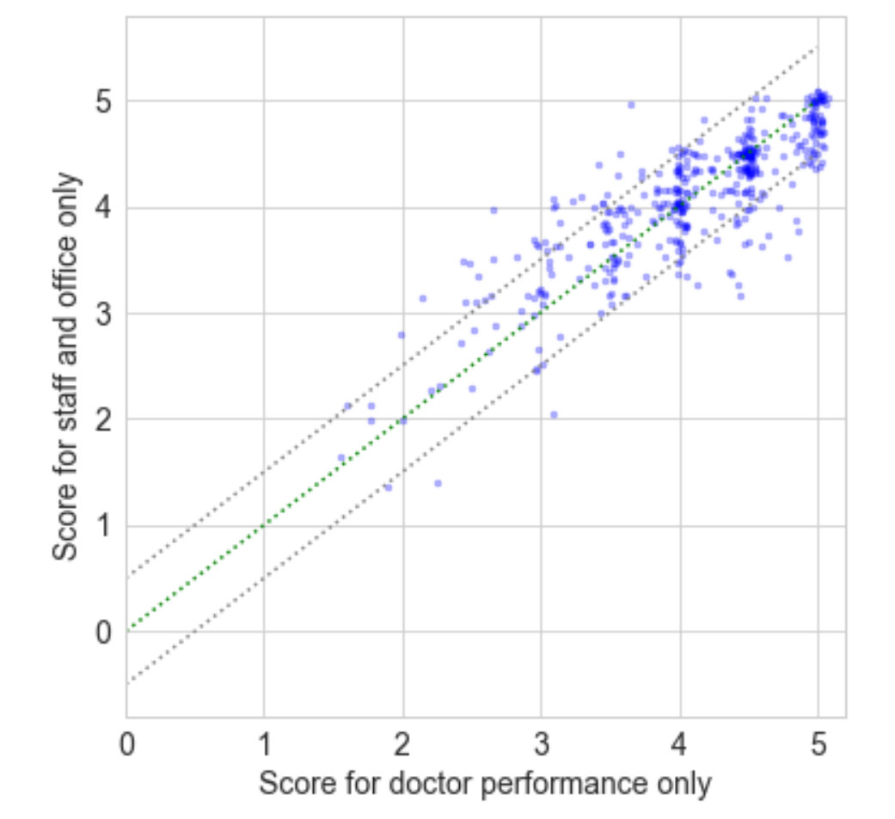
Staff scores and doctor scores are generally very concordant, but it is not uncommon for the two to differ by > 0.5 stars
Pearson Correlation
 | doc score | staff score | rating
doc score |  | 0.84 | 0.96
staff score |  |  | 0.86
rating
a.
b.
What happens to the overall rating when the staff’s score is
Higher than doctor’s score?
Lower than doctor’s score?
Notes:
Doctor score – Staff score:
Mean 0
Std: 0.4

Slide 13
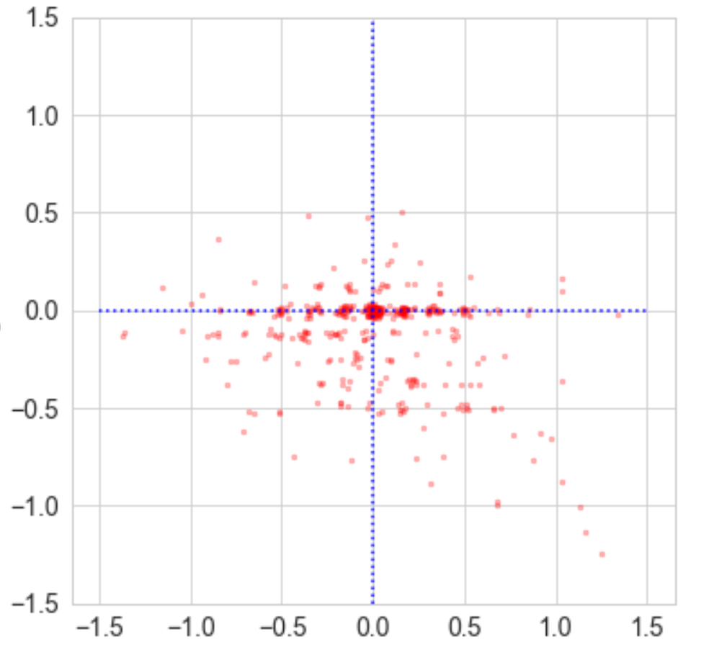
Overall likelihood to recommend a physician is primarily driven by physician factors, but can be dragged down by poor office and staff performance
When office and staff score is better than the doctor’s, it rarely lifts the overall rating
3
Most of the time, overall rating closely mimics the score for doctor’s performance
Overall rating – Doctor score
1
When office and staff quality is significantly below that of the doctor, overall rating suffers
2
Doctor score – Staff score
Notes:
Rating – doc score: distribution skewed to the negative side
Mean: -0.1
Std: 0.23

Slide 14
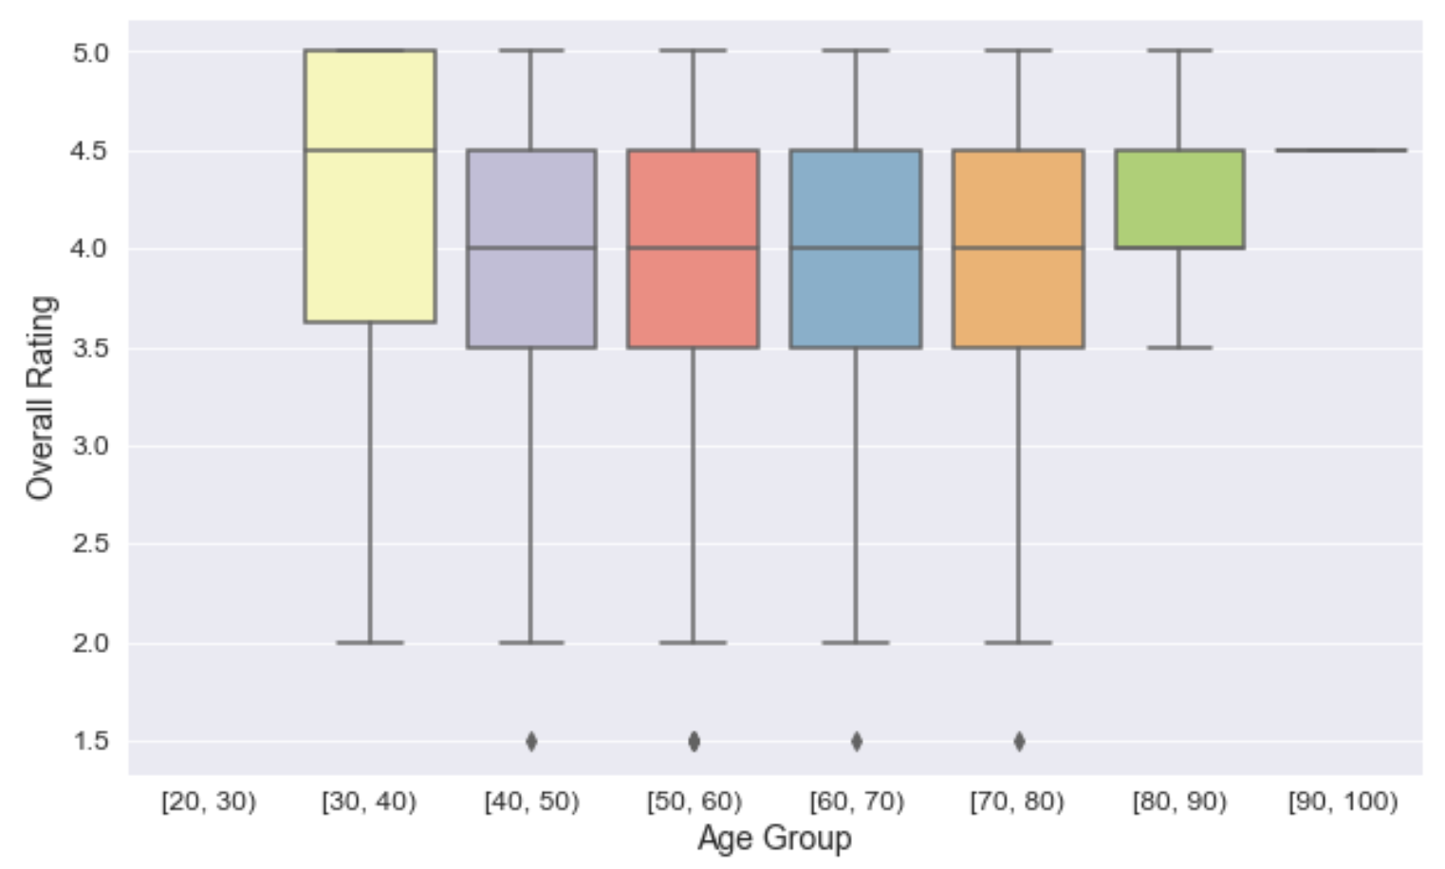
Surprisingly, more experienced doctors do not have a higher average rating than younger ones
N = 433
doctors with age information and ≥ 5 reviews
One way anova test shows there is no statistically significant difference between the group means
Notes:
N for [30,40) = 17
Age does seem to have an impact on doctor’s rating for cardiologists (correlation = -0.15),

Slide 15
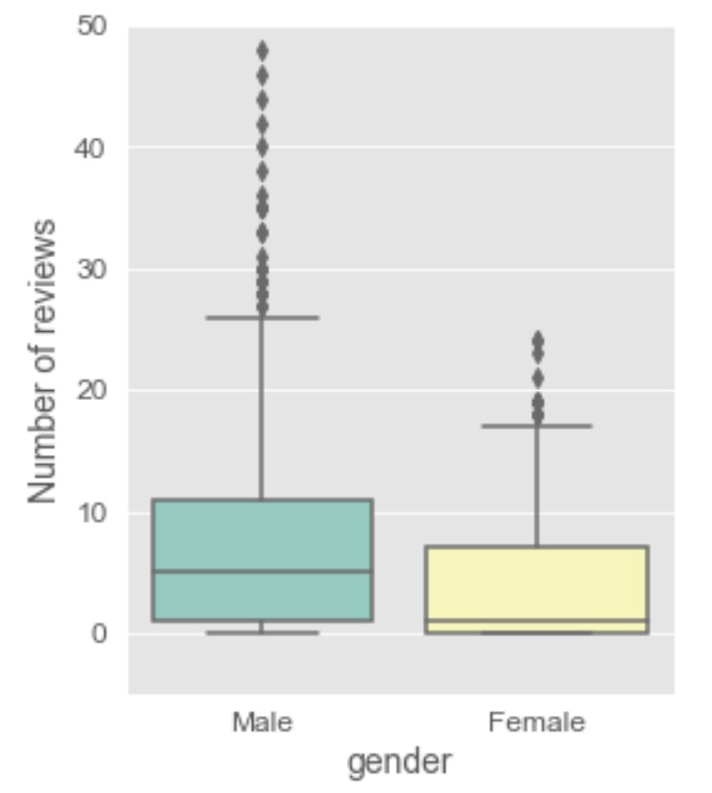
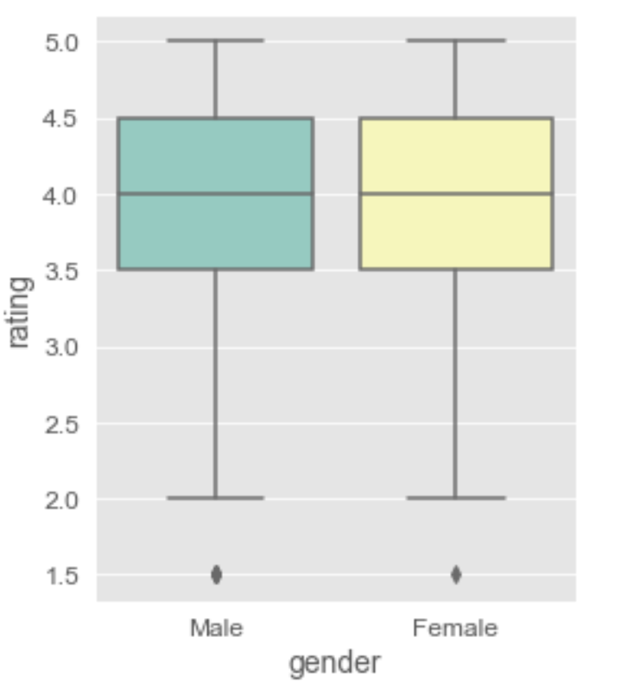
Number of reviews is biased by gender, but rating distribution is not
N = 947 (all doctors)
N = 404
(has gender info, and ≥ 5 reviews)
Female doctors tend to have fewer reviews than male doctors (p-val = 0.0002)
The doctors with > 25 reviews are almost all male
Notes:
Same trend holds true for cardiologists both in terms of number of reviews and rating distribution
GI mean Female: 4; Male: 8
Cardio mean Female: 2.8; Male 5.3

Slide 16
Conclusions
What healthgrades has done is a great effort, but the current data collected have a number of potential caveats, such as
Ratings heavily tilted toward the higher end and lack dynamic range
The way search result is ordered by “best match” may promote rich-gets-richer does not help generate reviews more evenly across the physician universe
GI doctors in NYC metro with different length of time in practice are perceived similarly by patients in terms of bedside matter and quality of interaction
Female GI specialists have much lower visibility on healthgrades as reflected by the smaller number of reviews, but their ratings do not differ from the male doctors
Overall rating is primarily driven by doctor’s own performance. Negative experience with the office staff can bring down the overall rating while positive experience generally does not lift the overall rating

Slide 17
Future work
Questions | Analysis
What are the doctor or staff qualities that patients appreciate the most? | Word cloud analysis of qualitative patient comments (associated with 5 stars) for top rated doctors
What are the doctor or staff qualities lend to very negative patient experience? | Word cloud analysis of qualitative patient comments (associated with low stars) for doctors with poorest ratings
Do the same trends hold in geographies other than NY metro? | Similar to this analysis and compare geographies
How do the rating trends differ by specialty? | Similar to this analysis and compare specialties
Trends from analysis of cardiologists in NYC metro very similar to those from the GI doctor analysis

Slide 18
Appendix

Slide 19
Healthgrades has a good coverage of physicians from a variety of specialties, including gastroenterologists
Healthgrades reports a larger number of doctors than AAMC
Healthgrades physician universe likely includes both active and inactive physicians
The ~950 gastroenterologists in New York metro area represent ~5% of all GI doctors in the nation
Association of American Medical Colleges, report link: https://www.aamc.org/data/workforce/reports/492560/1-3-chart.html

Slide 20
Quick look at the exceptional doctors shows that some are from large group practices and most completed fellowship in local hospitals
Top 2 practices based on number of exceptional doctors
Top 6 practices based on total # of GI doctors
Practice name | # of exceptional doctors
GOTHAM MEDICAL ASSOCIATES | 3 (10%)
Concorde Medical Group | 2 (7%)
Practice name | # | %
Mount Sinai Gastroenterology | 31 | 3.7%
Concorde Medical Group | 14 | 1.7%
Advantage Care Physicians | 11 | 1.3%
NYU LANGONE HOSPITAL CENTER | 10 | 1.2%
MOUNT SINAI HOSPITAL | 10 | 1.2%
GOTHAM MEDICAL ASSOCIATES | 9 | 1.1%

Slide 21
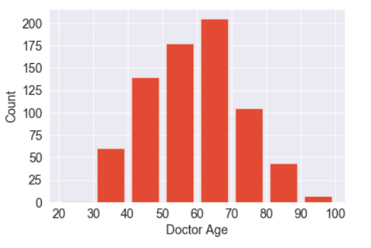
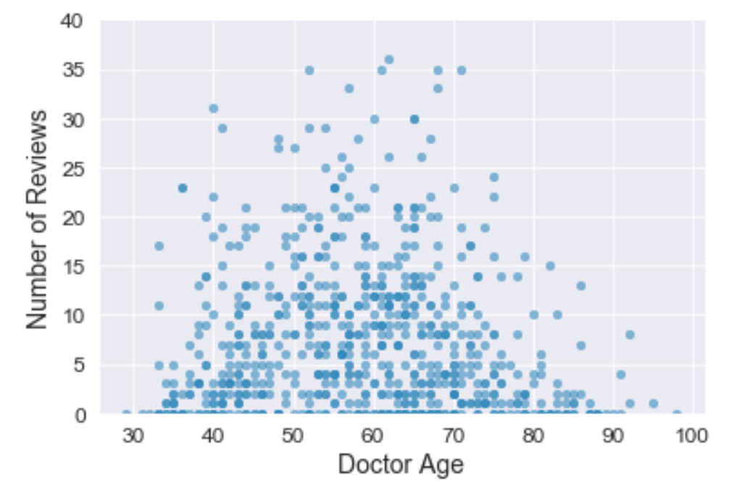
Gastroenterologists 50 to 70 years old account for 52% of the pool and tend to receive more patient reviews than other groups
N = 737 doctors with age information
28%
24%
19%
14%
8%
6%
The higher number of reviews per physician in the 50-70 age range could be due to:
More accumulated patients over time due to longer time in practice
Higher patient volume due to patient preference for physicians in this group

Slide 22
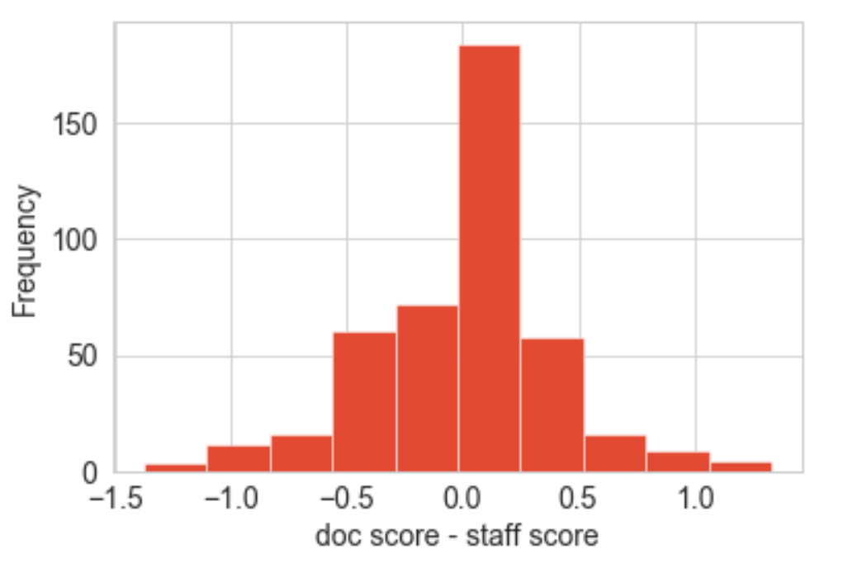
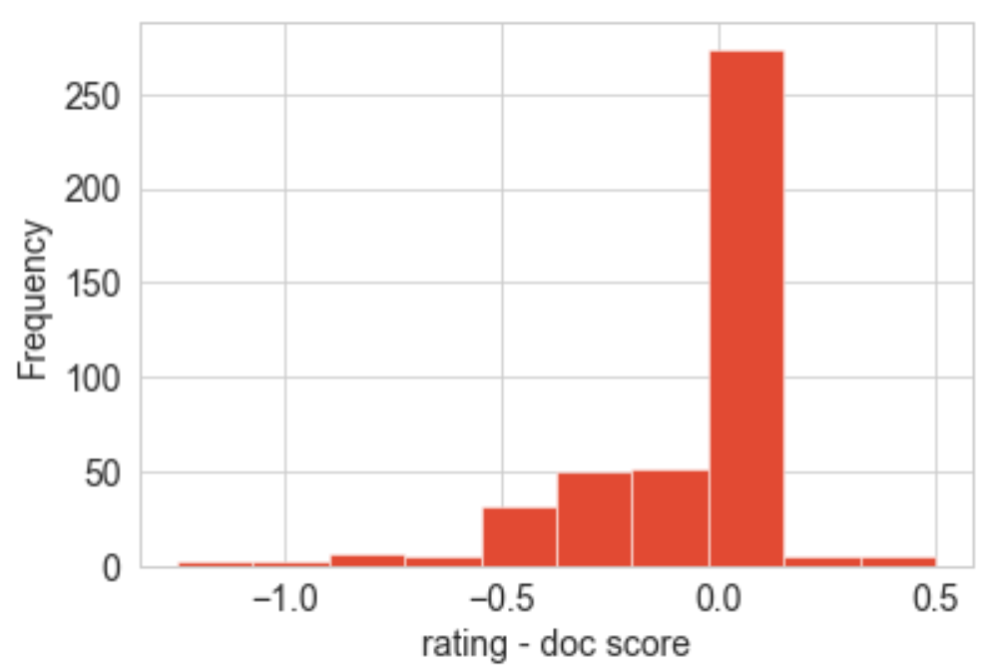
Doctor’s score is usually higher than the staff score and the overall rating is either same as doctor’s score or lower

Slide 23
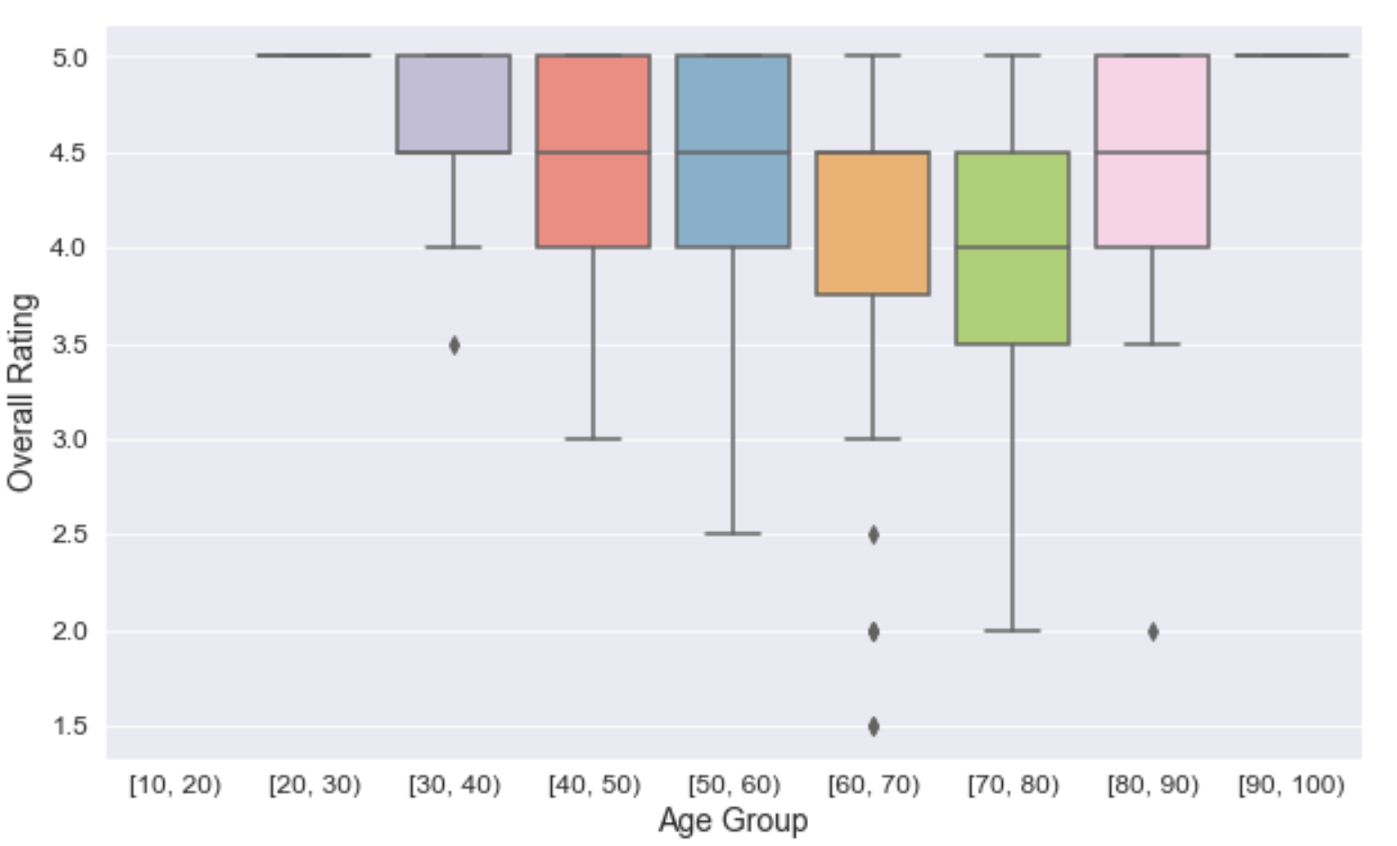
Patients are most satisfied with cardiologists in NYC metro area aged between 40 to 60 years old

